Slide 1
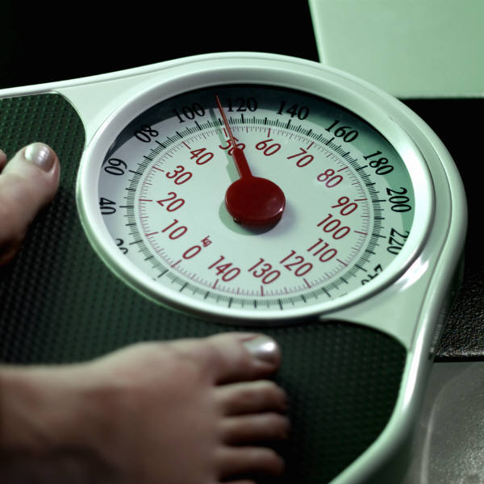
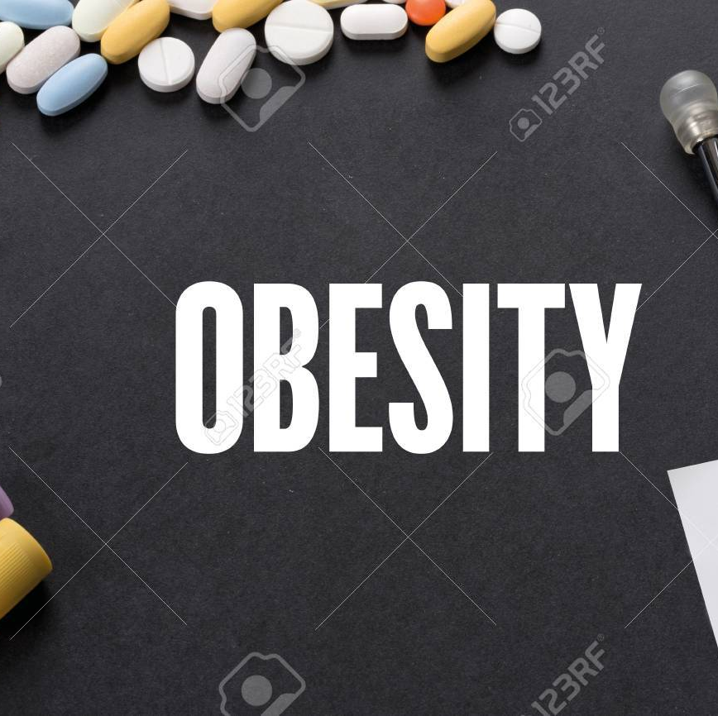
ASSIGNMENT #2 2021S_CBD 2214_1
BIG DATA FUNDAMENTALS - DATA STORAGE NETWORKING
Presented by
Lekshmi Chandran Sheela
Parvathy Vysakh
Patricia Adolph
Pooja Selby
Suchithra Chandrasekharan

Slide 2
Contents
INTRODUCTION
DATA DESCRIPTION
EXPLORATORY ANALYSIS
DATA PREPROCESSING
MODEL BUILDING
CONCLUSION

Slide 3
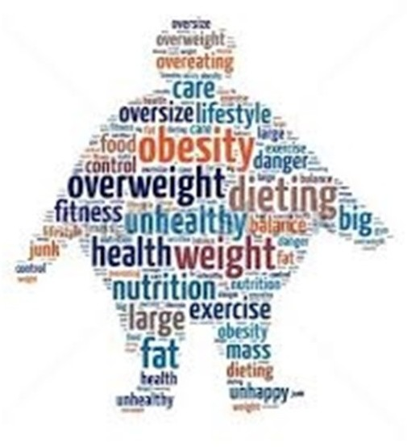
INTRODUCTION
Obesity is one of the chronic diseases, defined by genetic and environmental factors.
OBJECTIVE : Forecasting obesity among males and females separately.
Potential factors associated with obesity are high-calorie intake, lack of physical activity, genetic problems, hereditary, anxiety, or depression.
Body mass index (BMI) is a measure of body fat based on height and weight that applies to adult men and women.

Slide 4
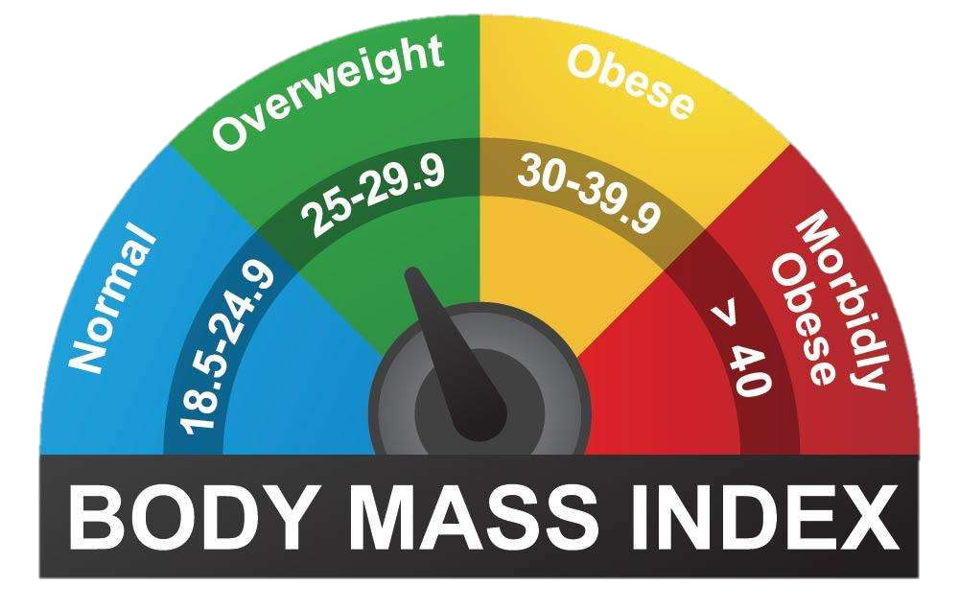

Slide 5
DATA DESCRIPTION
Dataset has 2111 records and 17 features.
Estimation of obesity levels in individuals from the countries of Mexico, Peru and Colombia, based on their eating habits and physical condition.
Classification in 7 groups: "Insufficient Weight", "Normal Weight", "Overweight Level I", "Overweight Level II", "Obesity Type I", "Obesity Type II" and "Obesity Type III".
Target variables - height and weight
Height and weight are used to classify a persons BMI. The BMI measure was then used to classify each observation.

Slide 6
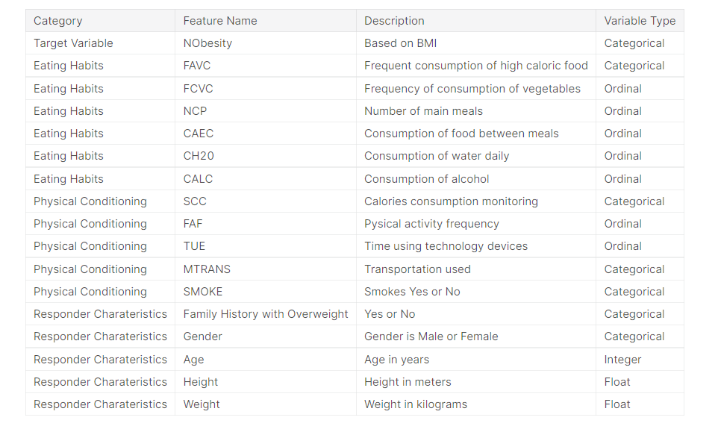
DATA DESCRIPTION…

Slide 7
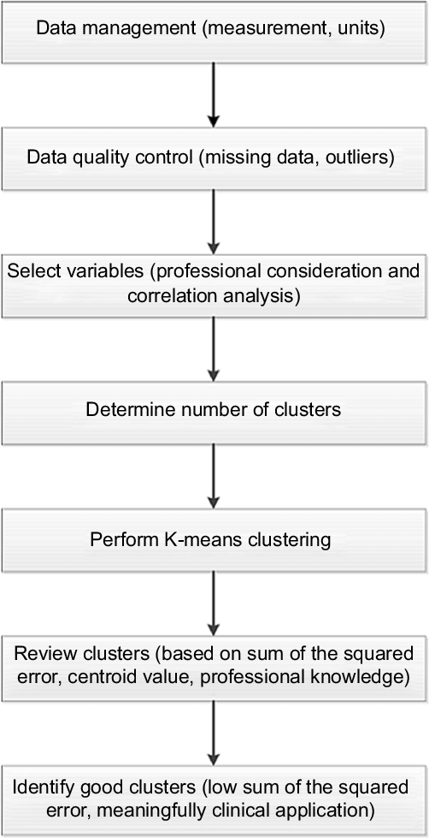
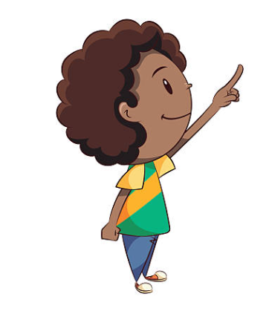
Steps performed in forecasting Obesity

Slide 8
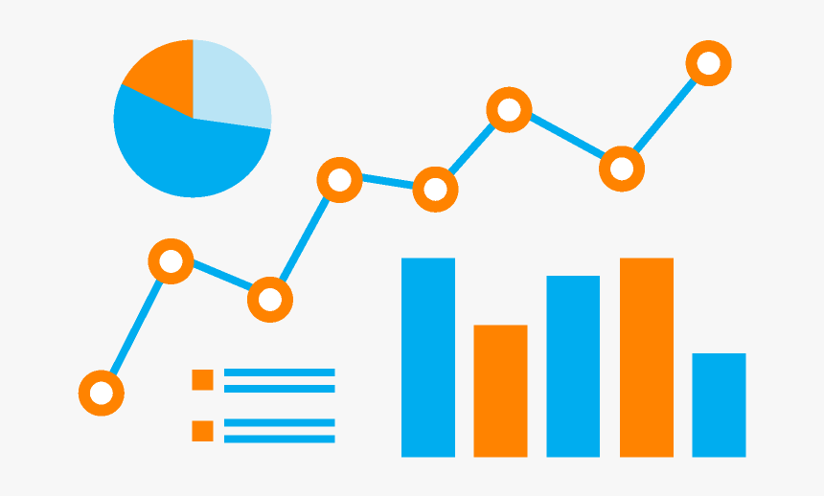
EXPLORATORY ANALYSIS
DATA CLEANING
Outlier Detection
Missing Value Handling
DATA VISUALIZATION
Histogram
Boxplot
Scatterplot
Heatmap
Countplot

Slide 9
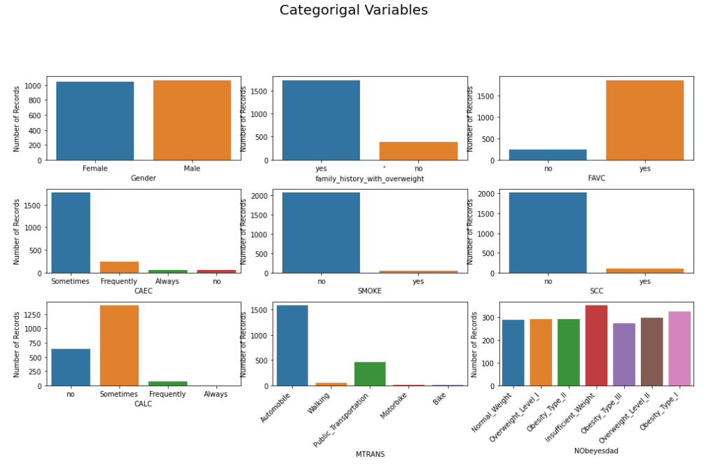
EXPLORATORY ANALYSIS…

Slide 10
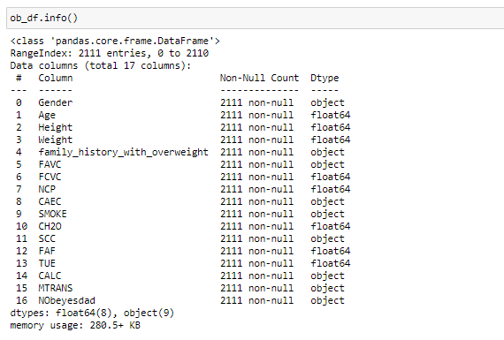
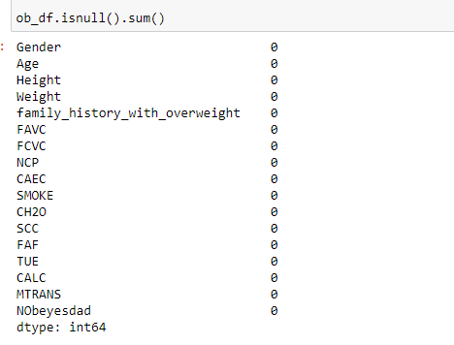
EXPLORATORY ANALYSIS…
Missing Value Detection

Slide 11
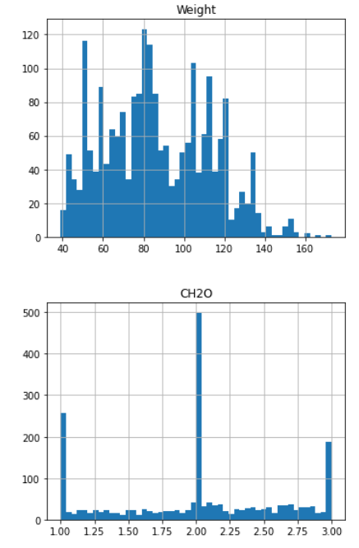
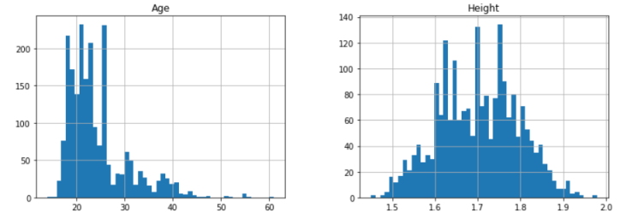
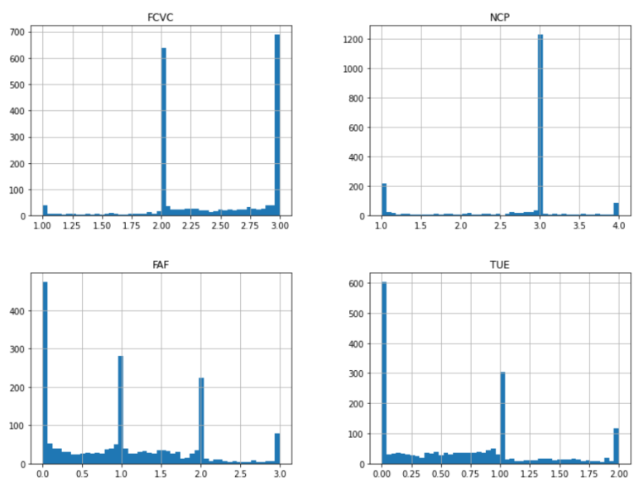
EXPLORATORY ANALYSIS…
Data Distribution

Slide 12
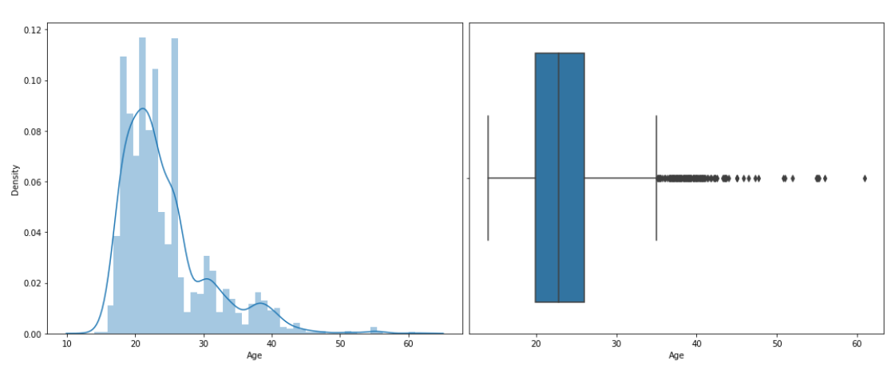
EXPLORATORY ANALYSIS…
Distribution of Numeric Variable

Slide 13
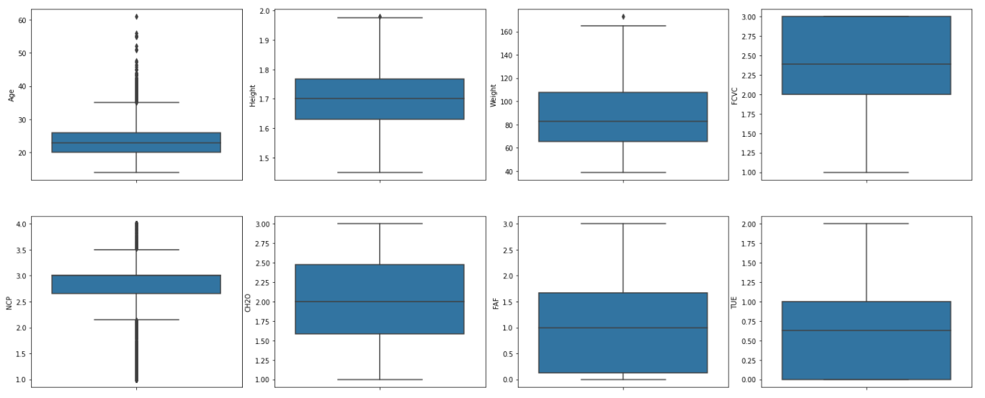
EXPLORATORY ANALYSIS…
Outlier Detection - Box plot of numeric features

Slide 14
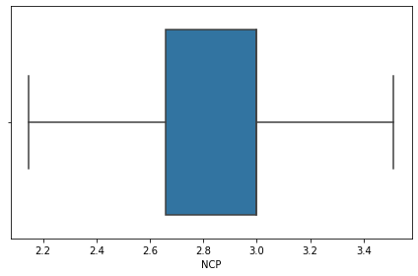
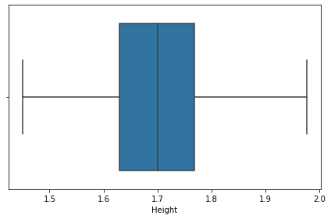
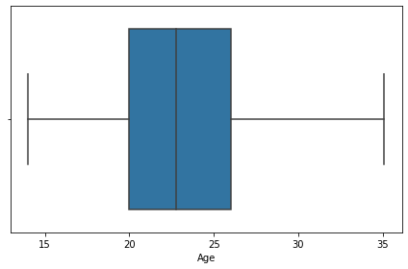
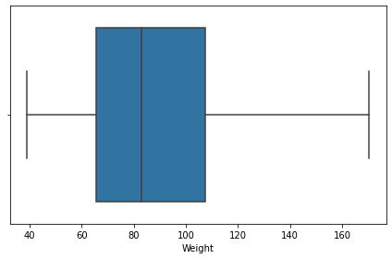
EXPLORATORY ANALYSIS…
After handling outliers

Slide 15
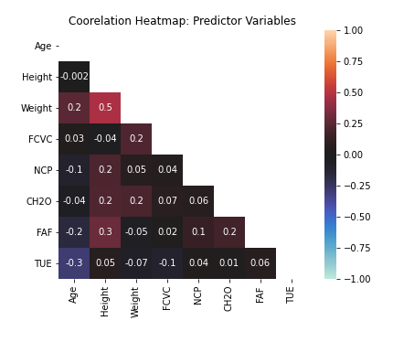
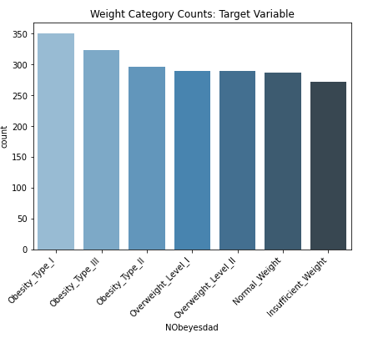
EXPLORATORY ANALYSIS…
Heat Map
Count plot

Slide 16
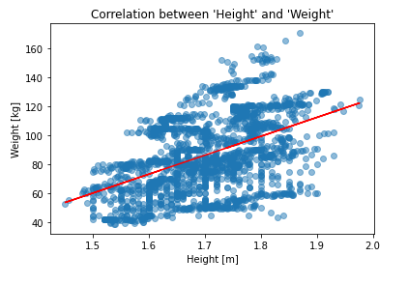
EXPLORATORY ANALYSIS…
Scatter plot – to show correlation
Red line - Positive correlation between height and weight
An increase in one variable leads to an increase in the other
Taller people are more likely to weight more.
Positive correlation between height and weight

Slide 17
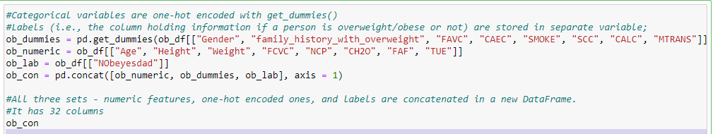
MODELING
Categorical variables are one-hot encoded
Categorical variables are gender, family history with overweight, FAVC, CAEC, SMOKE, SCC, CALC, MTRANS

Slide 18
K-means CLUSTERING…
How the K-means algorithm works:
Identify the number of clusters, K
Initialize centroid by shuffling the dataset and then randomly choose K data points without replacing them.
Keep on iterating the above step such that there is no change to centroids i.e., the clustering of data points does not change.
Calculate the sum of the squared distance between all the centroid and data points.
Allocate data points to the closest centroid.
Then calculate the centroid of each cluster taking into account the average of data points that are assigned to each subgroup.
Two metrics that give an understanding of k are
Elbow Method and Silhouette Analysis

Slide 19
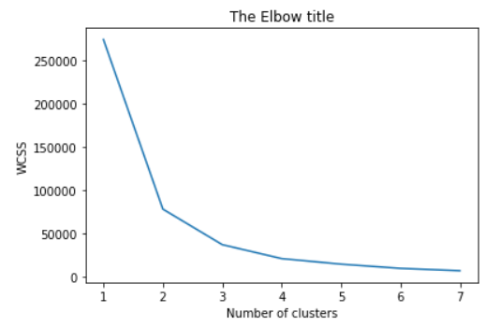
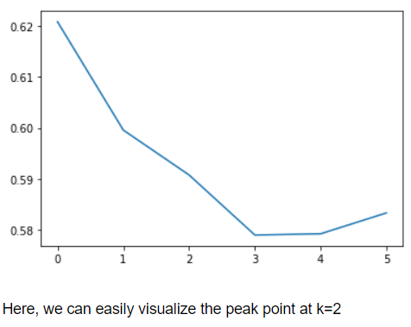
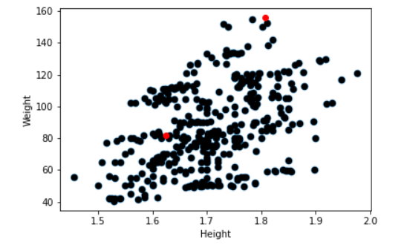
Finding the appropriate K based on Elbow Method and Silhouette Method
Modelling - K-Means Clustering

Slide 20

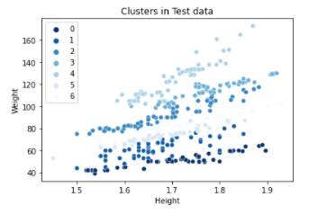
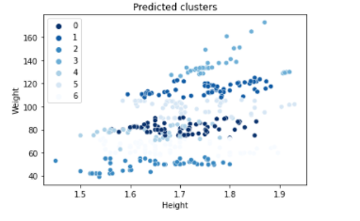
K-means CLUSTERING…

Slide 21
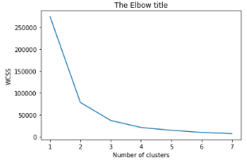
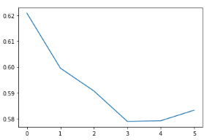

RESULT & IMPLEMENTATION
Finding the appropriate K based on Elbow Method
Finding the appropriate K based on Silhouette Method
Here, we find that the k=2 is the bend(elbow) point.
Silhouette score is 58.3%

Slide 22
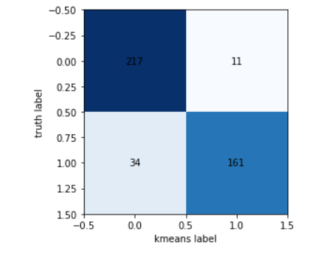
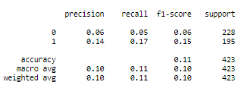

RESULT & IMPLEMENTATION
Confusion Matrix
Evaluation Metrics
Model Accuracy is 89.3%

Slide 23
CONCLUSION
An unsupervised K-means clustering roadmap to cluster overweight and obese population into clinically meaningful subgroups.
This method makes use of quantile-transformation of data to reduce the influences of outliers and irregular distribution.

Slide 24
THANK YOU

